Slide 1
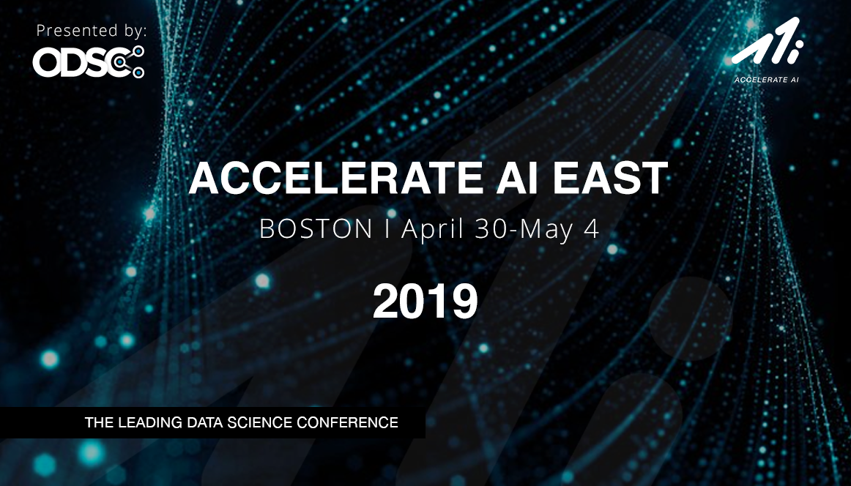
OPEN
DATA
SCIENCE
CONFERENCE
@ODSC

Slide 2
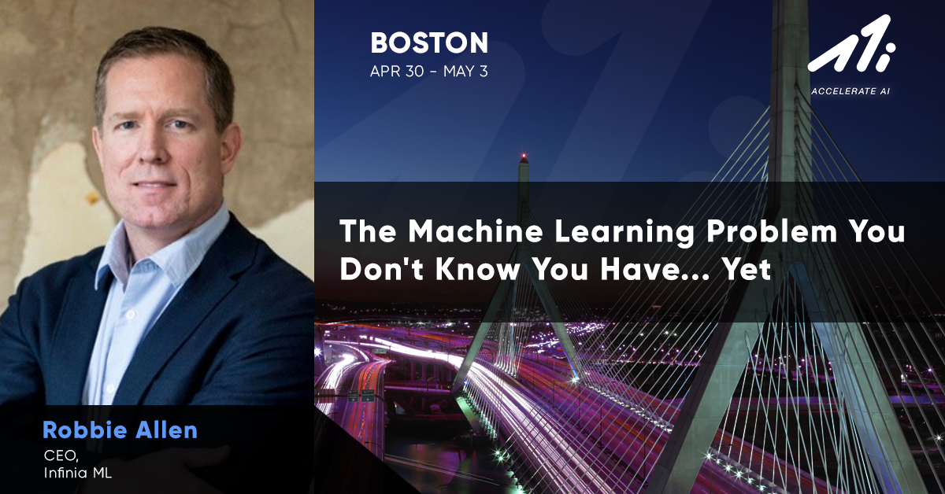

Slide 3

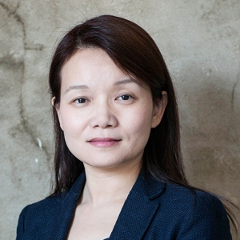
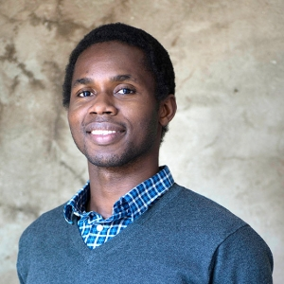
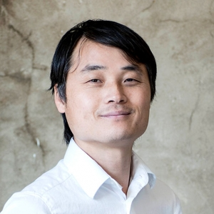
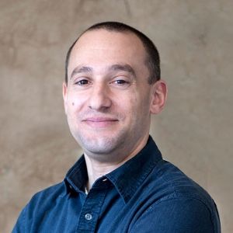



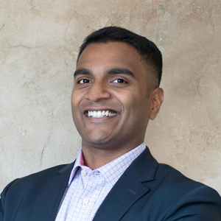
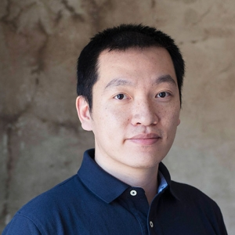

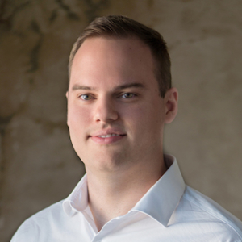


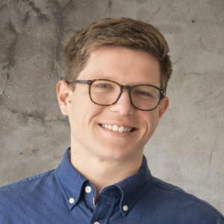
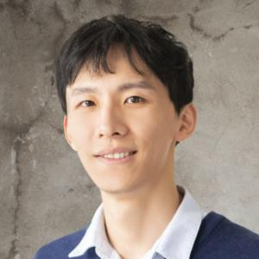






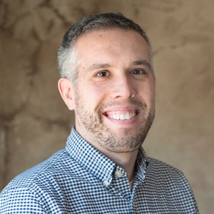
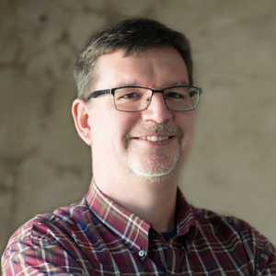
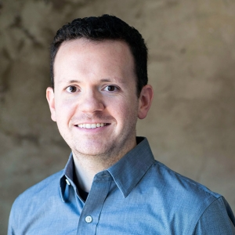
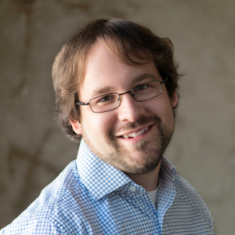


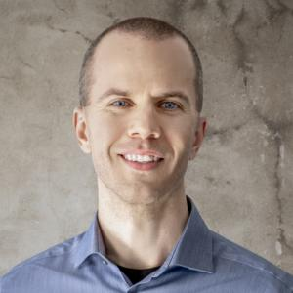
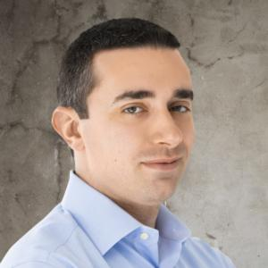
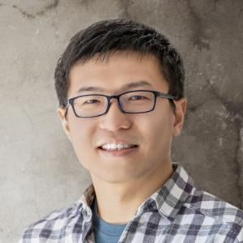
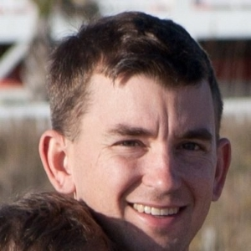


DATA SCIENCE
TEAM MEMBERS PREVIOUSLY WORKED WITH:
35
PATENTS
11
BOOKS
9
PHDs
ML DEVELOPMENT
600 +
PUBLISHED PAPERS

Slide 4
Gartner Hype Cycle Chart
Connected Home
Machine Learning
Smart Robots
Blockchain
Smart Workspaces
Quantum computing
Virtual Reality
Augmented Reality
Smart Dust
2-5 years
5-10 years
More than 10 years
JULY 2017

Slide 5
Technology Maturity S-Curve
Performance
Machine Learning
Time

Slide 6
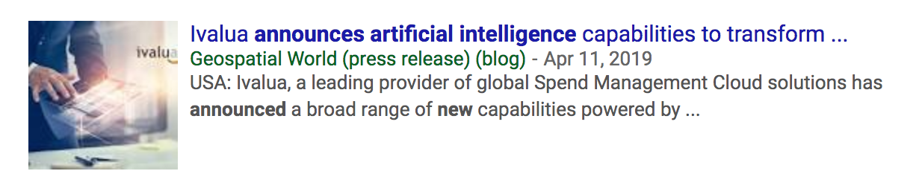

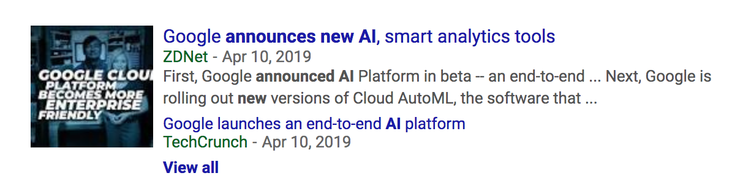
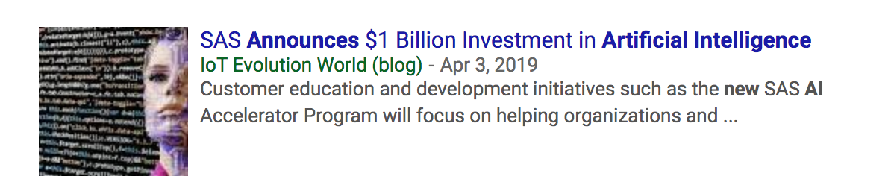
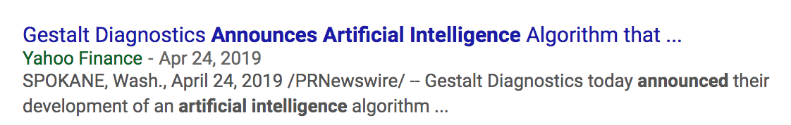
A Headline Does Not Mean Business Impact

Slide 7
Data Engineers
Data Scientists
Software Engineers
DevOps
DATA PREPARATION
STEP 1
DEVELOPMENT
STEP 2
DEPLOYMENT
STEP 3
Collect Data
Design Model
Deploy Model
Clean Data
Train Model
Retrain Model
Create Pipeline
Test Model
Monitor
Optimize Model

Slide 8

Model Development
is not the same as
Software Development

Slide 9
How do you measure success?

Slide 10
Doesn’t generalize to other use cases
(even very similar use cases)

Slide 11
Performance starts degrading as soon as it is put into production
Seasonality
Changes in Production Data
New events and patterns
The new system itself will change the environment

Slide 12
Data Engineers
Data Scientists
Software Engineers
DevOps
DATA PREPARATION
STEP 1
DEVELOPMENT
STEP 2
DEPLOYMENT
STEP 3
Collect Data
Design Model
Deploy Model
Clean Data
Train Model
Retrain Model
Create Pipeline
Test Model
Monitor
Optimize Model

Slide 13
Where is the Business Impact?

Slide 14
Business Owner
Data Engineers
Data Scientists
Software Engineers
DevOps
Business Owner
DEFINITION
STEP 0
DATA PREPARATION
STEP 1
DEVELOPMENT
STEP 2
DEPLOYMENT
STEP 3
BUSINESS IMPACT
STEP 4
Scope Problem
Collect Data
Design Model
Deploy Model
Measure Results
Define Metrics
Clean Data
Train Model
Retrain Model
Validate Impact
Create Pipeline
Test Model
Monitor
Reassess
Optimize Model

Slide 15

What are you Monitoring?

Slide 16

In Production?
Need plan for ongoing Learning

Slide 17
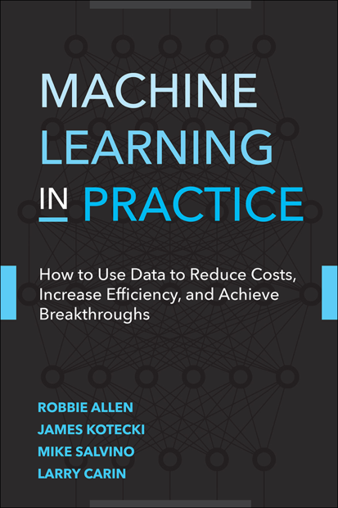
Coming soon…
Book for executives, managers, & project managers
Publisher: Addison-Wesley
Read early chapter drafts: machinelearninginpractice.com

Slide 18
Thank you!
robbie.allen@infiniaml.com

